Slide 1


Day 8: Building Dynamic Web Pages with PHP
From Simple Forms to Dynamic Applications
FULL STACK BOOTCAMP
DAY 8 OF 13
2 HRS 30 MIN

Slide 2



Yesterday We Collected Data. But Can We Make It Look Like This?
You built a form. A user filled it in. And then… nothing special happened. Today we change that. Think about Google Forms — when you submit, you land on a polished, personalized Thank You page. How is that page generated? Hint: it's not magic. It's PHP reading what you submitted and building the page dynamically, in real time.
Pause. Let students think. Don't answer immediately — let the question land.

Slide 3

Today's Mission 🚀
By end of session, every team ships a Student Registration Confirmation System — a real, working multi-page PHP application.
Bootstrap Form
Confirm Page
POST Submit
PHP Validate
Run Grading
This is not a toy project. It uses Bootstrap, PHP, validation, functions, and reusable includes — everything a real app needs. Keep this flow in mind throughout the day.

Slide 4
⚡ Rapid-Fire Recap — 5 Minutes
Quick pair discussion before we push forward. No notes, no Googling — just talk it out with your partner.
How do you run a PHP file?
What is localhost?
What does echo do?
HTML vs PHP?
Your own machine acting as a web server, served by Apache inside XAMPP.
Outputs text or HTML directly into the browser response.
HTML is static markup; PHP runs server-side and generates HTML dynamically.
Via localhost in XAMPP — never directly from the filesystem.
What is $_POST?
A superglobal array holding form data sent via the POST method.

Slide 5

MODULE 1
GET vs POST
GET — Data in the URL
POST — Data hidden in the body
<form method="get" action="result.php"> <input name="name" /> <button>Submit</button> </form>
<form method="post" action="result.php"> <input name="name" /> <button>Submit</button> </form>
URL becomes: result.php?name=Martin
Use for search queries, filters, bookmarkable pages.
URL stays clean: result.php
Use for login, registration, sensitive or large data.
Live Code Now: Create both forms side by side. Open browser and compare URLs after each submit. See the difference visually.

Slide 6
MODULE 1 — MISSION + CHALLENGE
🎯 Mission: Feedback Form via POST
🎯 Your Mission
🏆 Code Challenge
Build a Bootstrap feedback form with three fields:
Upgrade your result page to display a personalized greeting using the submitted name:
Name — text input
Email — email input
Message — textarea
<?php $name = $_POST['name']; echo "<h2>Thank you, $name!</h2>"; ?>
On submit, display the submitted data using $_POST in a styled result page.
Style the output using a Bootstrap alert-success card. Make it look polished.

Slide 7
MODULE 2
Conditional Logic in PHP
Conditions let PHP make decisions. Syntax is identical to JavaScript — but remember the semicolons and PHP tags.
<?php
$cgpa = $_POST['cgpa'];
if ($cgpa >= 9) {
echo "

Slide 8
MODULE 2 — MISSION + CHALLENGE
🎯 Mission: Student Grade Checker
🎯 Your Mission
🏆 Code Challenge
Build a form where a student enters their CGPA. On submit, PHP reads the value and outputs a personalized performance message.
Level up the output by using different Bootstrap alert colors to reflect each grade band:
Input: one number field for CGPA (e.g. 8.7)
Output: performance message based on range
Wrap everything in a Bootstrap card for polish
alert-success → Excellent
alert-primary → Very Good
alert-warning → Good
alert-danger → Keep Improving
The color should change dynamically based on the PHP condition result.

Slide 9
MODULE 3
PHP Functions — Write Once, Reuse Everywhere
Functions eliminate repetition. Define once, call anywhere. PHP functions work just like JavaScript functions — same concept, slightly different syntax.
<?php
function greetStudent($name) {
return "Welcome, $name!

Slide 10
MODULE 3 — MISSION + CHALLENGE
🎯 Mission: Welcome Card Generator
🎯 Your Mission
🏆 Code Challenge
Build a form that collects three inputs:
Add the current date to your welcome card using PHP's built-in date function:
Student Name
Branch (e.g. Computer Science)
College Name
<?php function getFormattedDate() { return date("l, F j, Y"); } // Output: Monday, June 9, 2025 ?>
On submit, call a PHP function that returns a formatted, Bootstrap-styled Welcome Card displaying all three fields.
Display it below the student's name on the card. Bonus: add a greeting that changes by time of day using date('H').

Slide 11
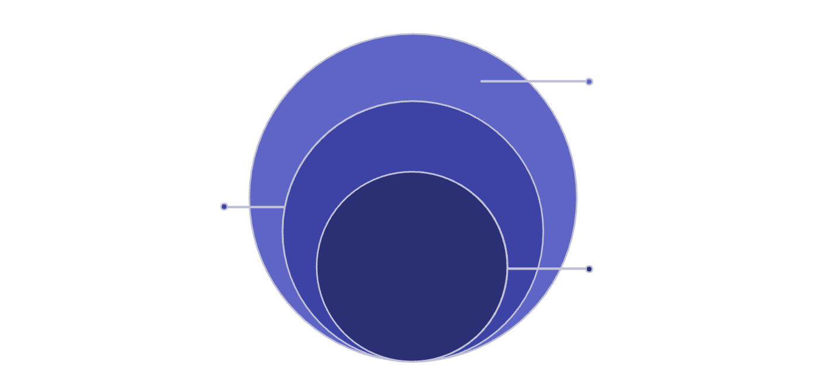
MODULE 4
Reusable Pages with include
Professional PHP apps never repeat code. A single header.php powers every page of the site — change it once, update everywhere.
File Structure
/project ├── header.php ├── footer.php └── index.php
Footer.php
Layout closure and common scripts
Index.php
Unique page content rendered for each route
index.php
Header.php
Site branding and navigation shared across pages
<?php include 'header.php'; ?> <main class="container"> <h1>Welcome!</h1> <p>Page content here.</p> </main> <?php include 'footer.php'; ?>
This pattern is used by every major PHP framework: Laravel, WordPress, CodeIgniter. Master it now and it applies everywhere.

Slide 12
MODULE 4 — MISSION + CHALLENGE
🎯 Mission: Split Your Site into Reusable Files
🎯 Your Mission
🏆 Code Challenge
Refactor your existing project into three separate files:
Add a Bootstrap navbar to header.php with links to at least three pages. Then highlight the active page dynamically using a PHP variable:
header.php — Bootstrap navbar, meta tags, CSS links
footer.php — copyright, scripts, closing tags
index.php — unique page content only
<?php $page = "home"; ?> <?php include 'header.php'; ?>
Use include to assemble the full page. Confirm it renders identically in the browser via localhost.
Inside header.php, add class="active" to the correct nav link using an if condition on $page.

Slide 13


🐛 BUG HUNT
Spot the Bug — Can You Find All 5?
The following PHP page is broken. Working in pairs, identify every bug before the reveal. There are exactly 5 bugs hidden in this code.
<?php $name = $_POST['student_name'] $cgpa = $_GET['cgpa']; if ($cgpa >= 9) { $grade = "Excellent" } else { $grade = "Keep Improving"; } echo "<h2>Welcome $Nam!</h2>"; ?> <?php include 'hedr.php'; ?>

Slide 14
🚀 BUILD SPRINT
30 MINUTES
Build Sprint: Student Registration Confirmation System
Time to put it all together. This is a hackathon-style sprint — build fast, build clean, build something you're proud to demo.
✅ Bootstrap Form
✅ POST + Validation
Name, Email, CGPA, Branch, College — styled with Bootstrap 5 form components.
All fields sent via POST. PHP checks for empty inputs before processing.
✅ Grade Logic
✅ Welcome Card
Use your calculateGrade() function with Bootstrap alert colors.
A polished confirmation card showing all submitted details and today's date.
✅ Header & Footer
⭐ Bonus
Use include for shared layout — navbar, branding, footer.
Profile photo placeholder, Font Awesome icons, gradient background on confirmation card.

Slide 15
🧠 INTERVIEW QUIZ
5 PHP Interview Questions
These questions come up in real internship and junior developer interviews. Answer without looking at your code.
Q1
Q2
Q3
What is the difference between GET and POST? When would you use each?
Why would you use include() instead of copying code into every page?
What is $_POST? What data type is it?
Q4
Q5
What does this output?
$x=7; if($x>8){echo "A";}else{echo "B";}
Why use a function instead of writing the same logic multiple times in a page?

Slide 16

📋 ASSIGNMENT
Improve Your Project Tonight
Your build sprint was 30 minutes. Tonight you have hours. Elevate your Registration Confirmation System into something portfolio-worthy.>
Feature Upgrades
🚀 Submit to GitHub
Student Photo Upload UI
Push your completed project to your GitHub repository with a clear README.md that describes what the project does.
Add a file input field styled with Bootstrap. (Display placeholder for now — no server upload needed.)
Students who complete the bonus features and push to GitHub on time get priority demo slots on Day 9.
More Fields
Add Gender (radio), Course (dropdown), and Address (textarea) to the form.
Better Bootstrap Design
Use cards, badges, icons (Font Awesome), and a gradient header on the confirmation page.

Slide 17

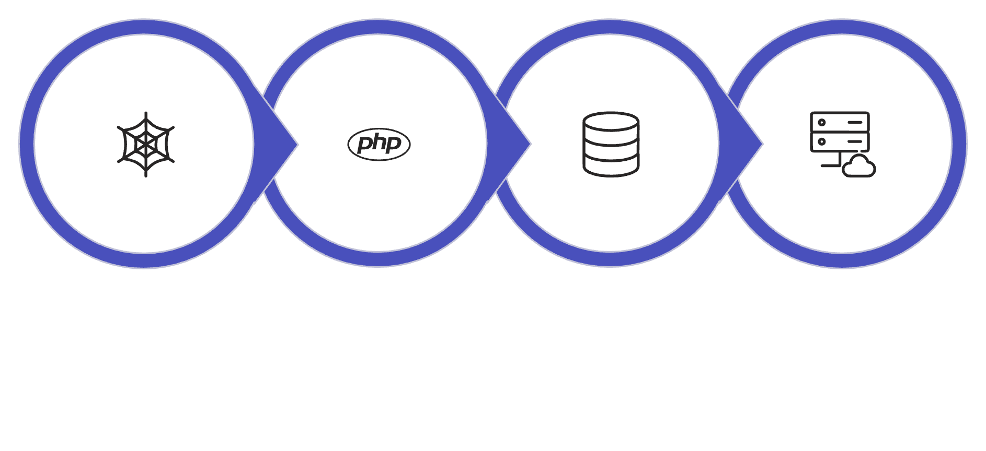
COMING TOMORROW
DAY 9
Tomorrow: Saving Data Permanently
Browser Form
PHP Processes
MySQL Stores
Data Retrieved
Today your application processed information. Tomorrow you'll store it permanently inside a database — and retrieve it whenever you want.
Day 9 introduces MySQL, phpMyAdmin, and your first INSERT query. Everything you built today becomes the front-end of a real database-driven application.

Slide 18
See You Tomorrow 🚀
Push your project. Document your code. Get some rest — Day 9 is where things get seriously powerful.
Push to GitHub
Review Today's Code
Preview MySQL
Commit your Day 8 project with a clear README before midnight.
Read through your functions and includes one more time — reinforce the patterns.
Open phpMyAdmin at localhost/phpmyadmin — we start there tomorrow.
FULL STACK BOOTCAMP — DAY 8 COMPLETE

